Slide 1
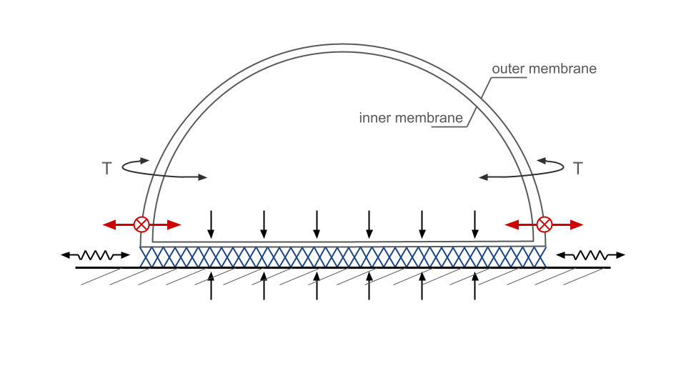
Active tensegrity-based foundation for moonquake rejection
Piero Risi Mortola
MECE 6388 Optimal Control Theory
University of Houston

Slide 2
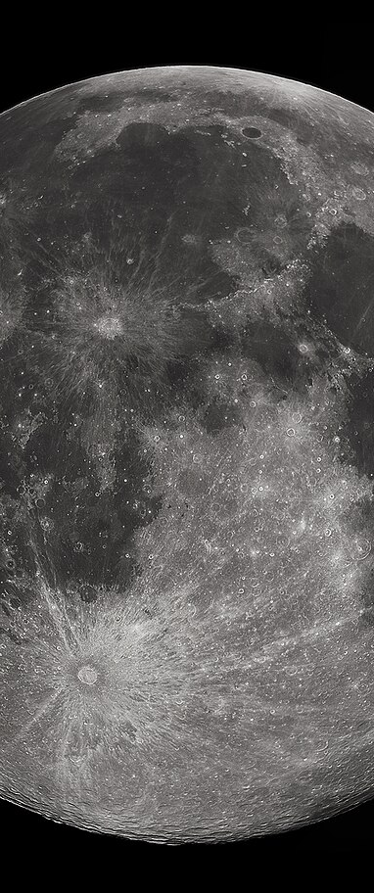
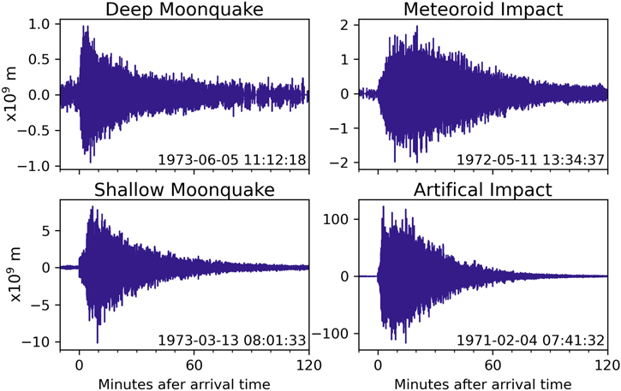

Motivation
Increased global interest on lunar exploration and permanent lunar base
Minimize weight of lunar structure
Moon-quakes can be long lasting, often for hours, though much weaker
Ceri Nunn et al 2022 Planet. Sci. J. 3 219

Slide 3
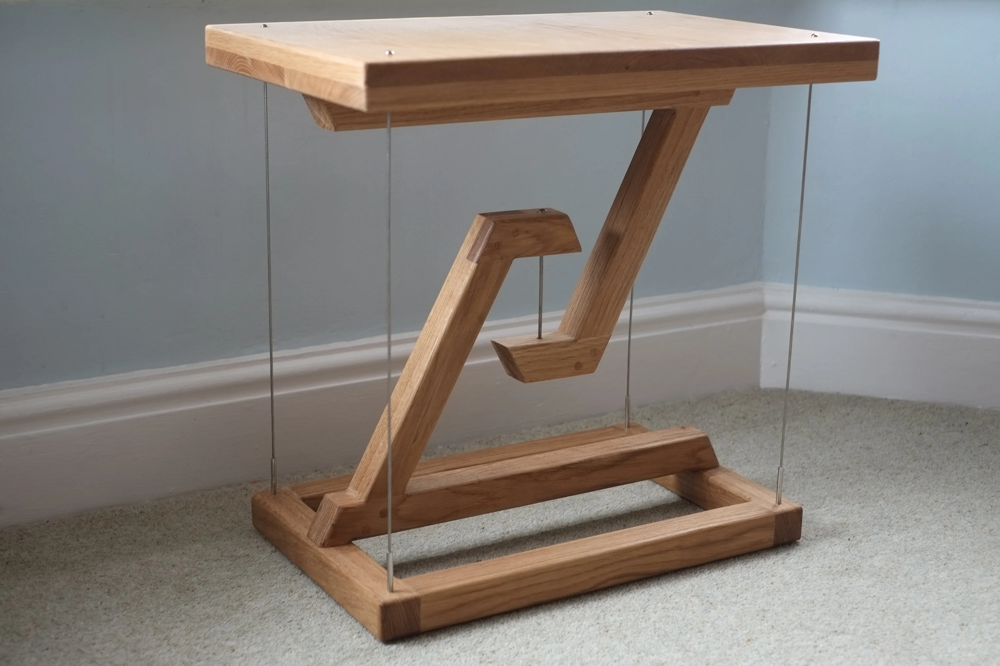
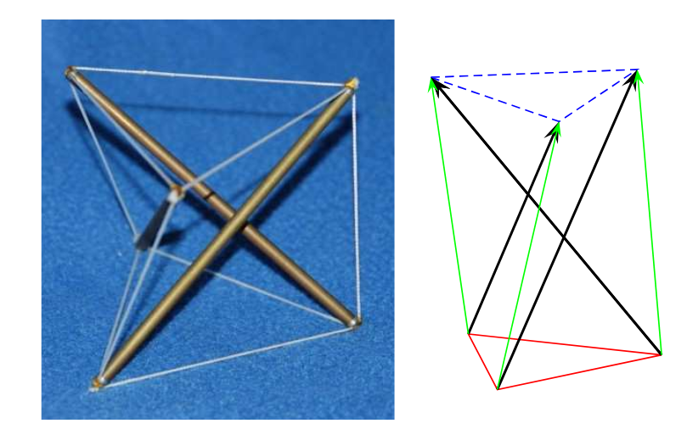
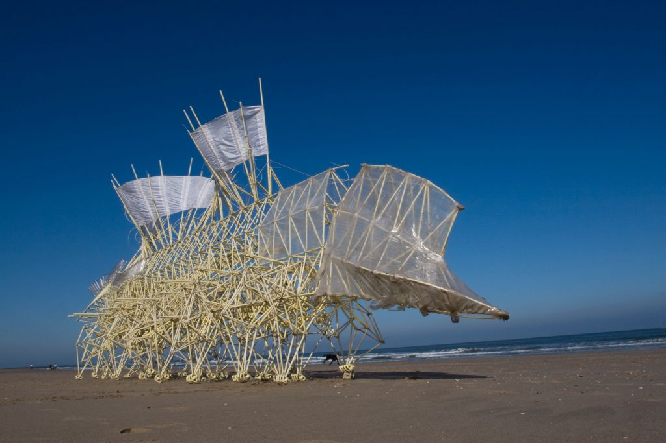
Tensegrity structures
Structures comprised of bars and strings
Design minimizes mass for a given loading condition
Actuators can control string length and string tension
Can actively change structure stiffness or change the structure shape
Tensegrity table
Tensegrity prism
Theo Jansen Sculpture

Slide 4
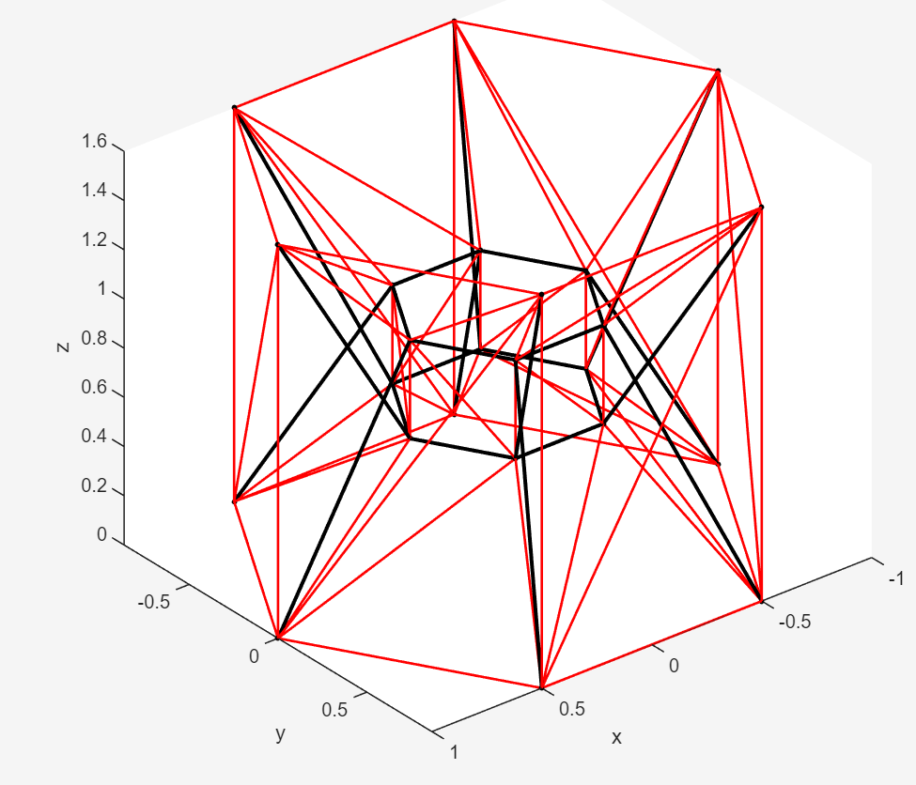
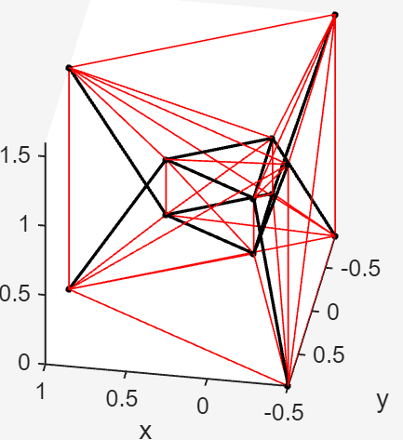
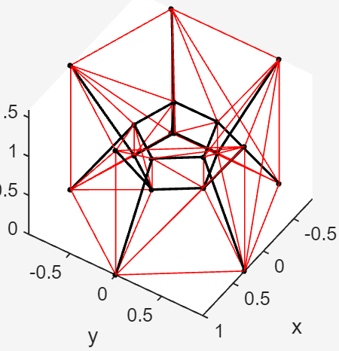
Structure concept - unit
Hexagonal unit
Hexagonal shape allows for tessellation and has high stability
Cables in red
Cables will only carry tension
Bars in black
Bars can carry both tension and compression

Slide 5
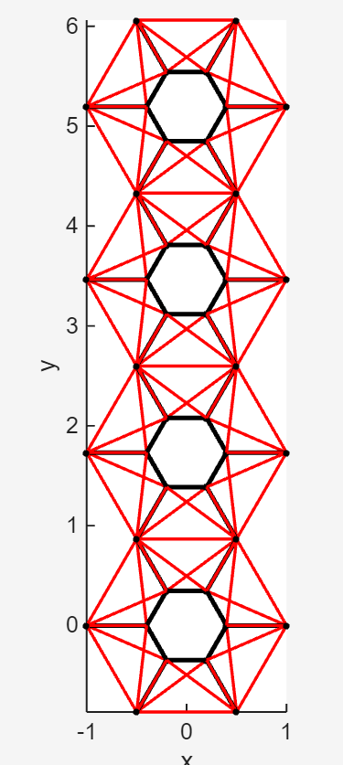
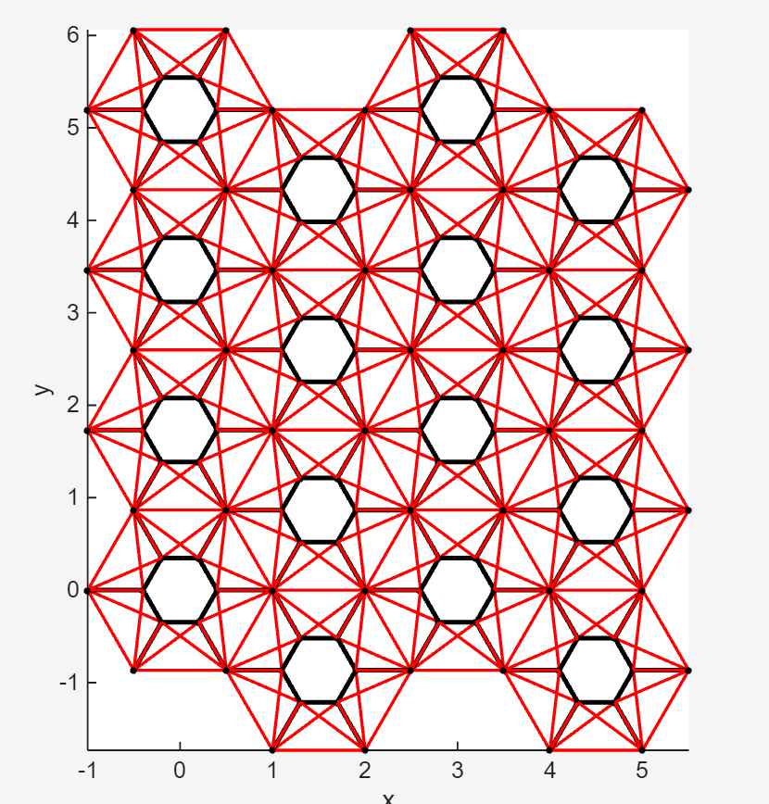
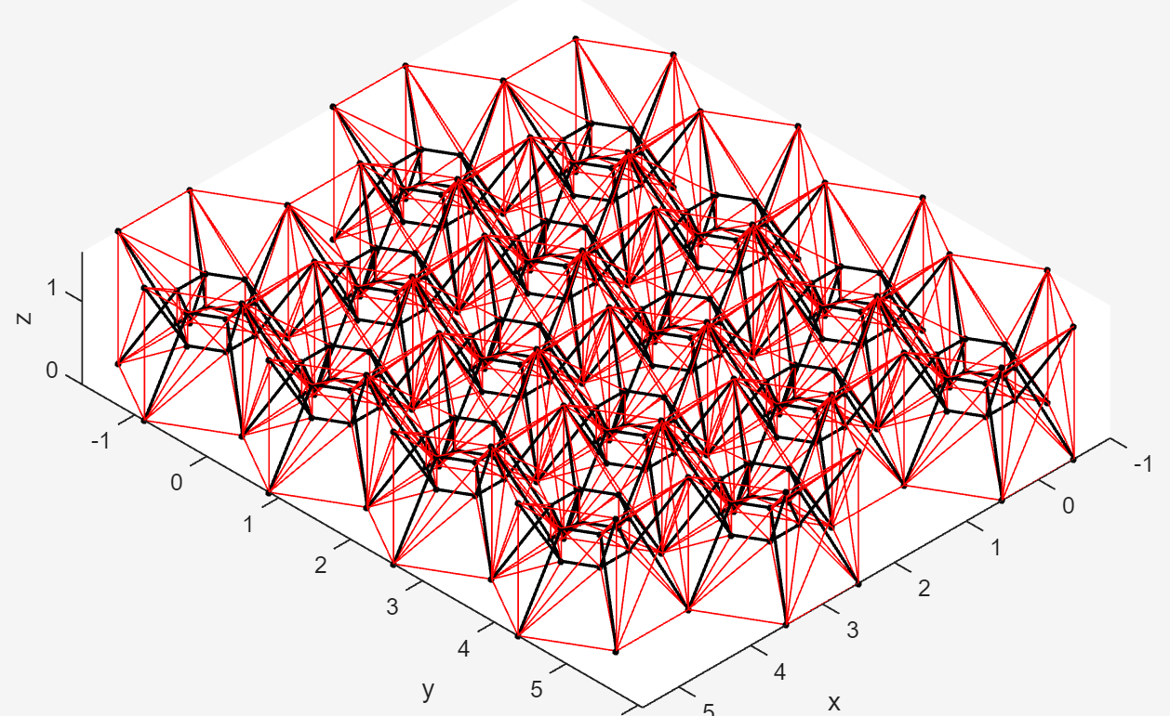
Full structure concept
Units tessellated to create a foundation
Top nodes will carry the weight of the habitat/structure
Bottom nodes fixed to the ground
Tessellated structure, 4 by 4 tessellation

Slide 6
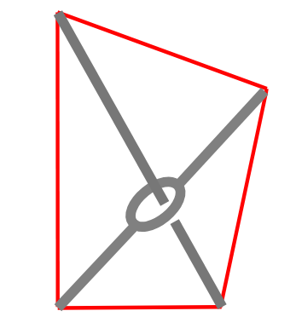
Modeling - Assumptions
Small displacements
Bars and strings is assumed to be linear elastic
Mass of tensegrity structure clustered at the nodes
Axial load members only
Ground nodes are fixed to ground
Strings can only be in tension
Ground motion modeled as a sinusoid, no vertical component

Slide 7
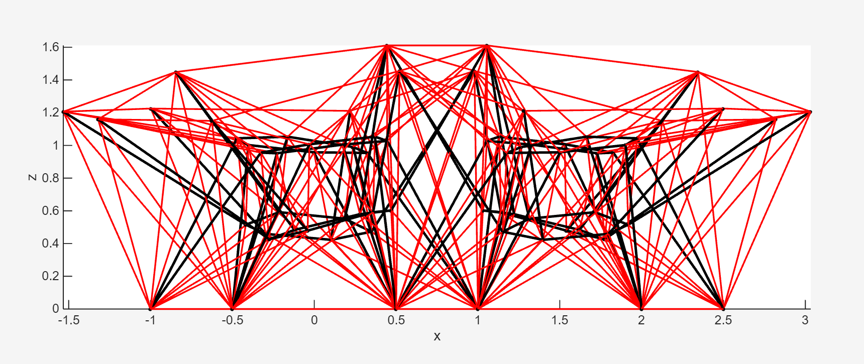
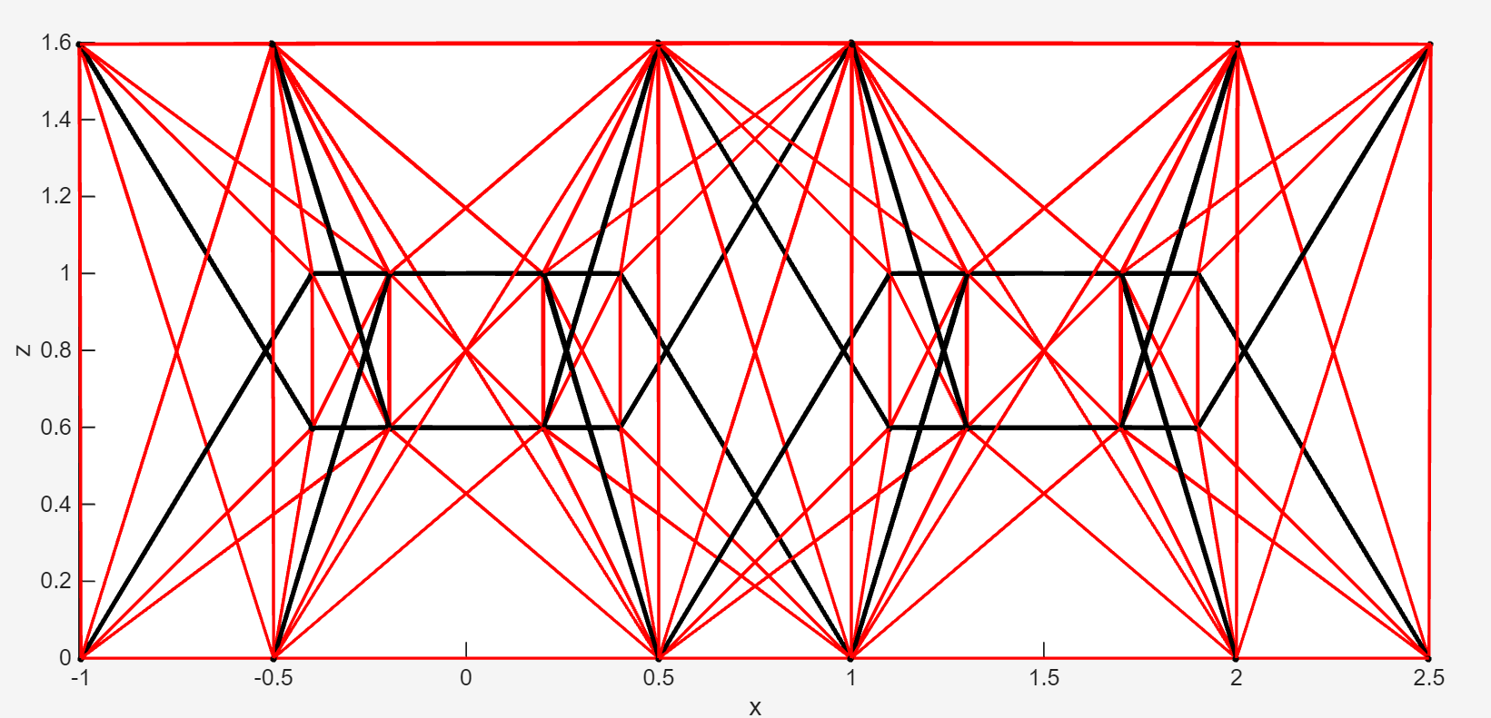
Statics analysis
Foundation will support a structure on the top nodes (i.e. a lunar habitat)
Weight of structure is modeled as a distributed weight on top nodes
Resulting equilibrium nodal positions used in dynamics analysis

Slide 8
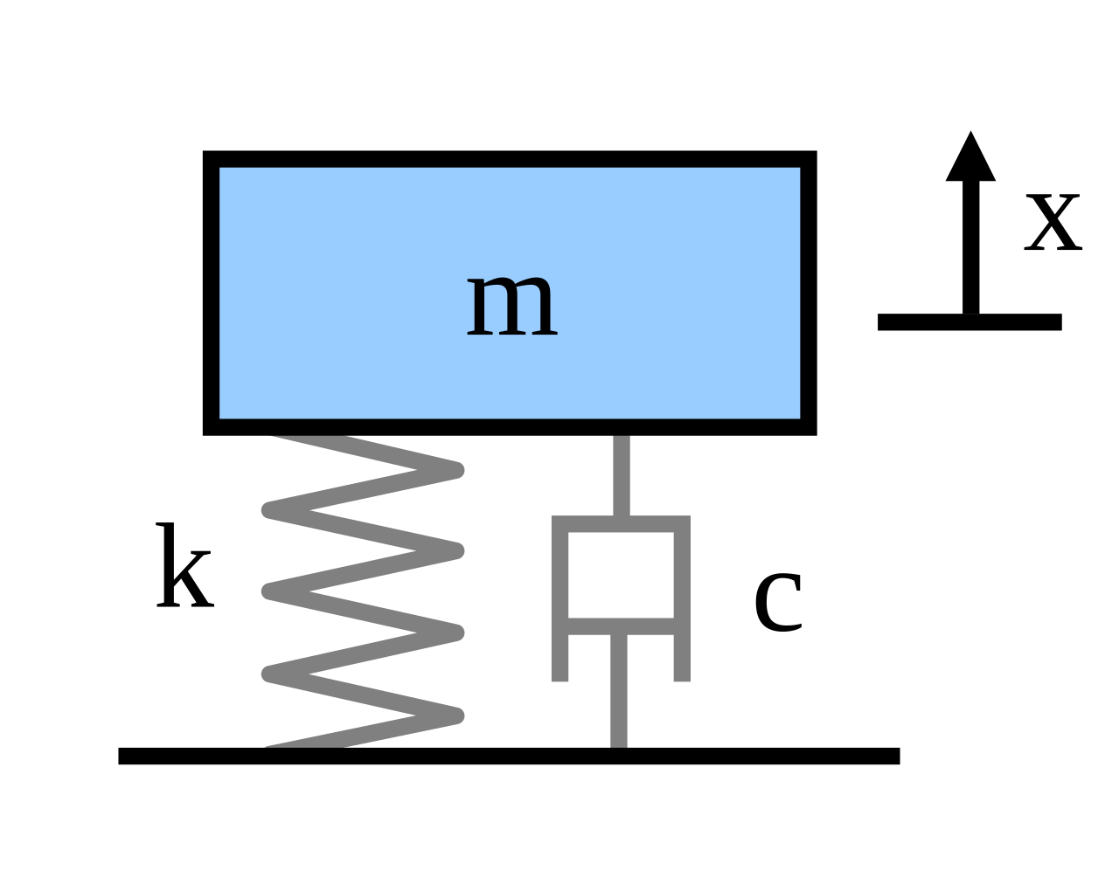
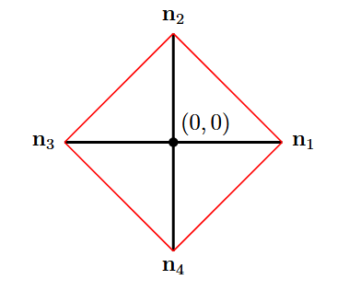



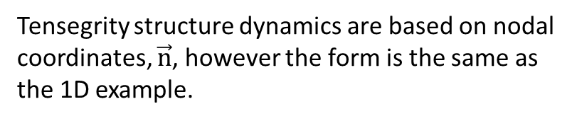


Dynamics formulation
$$f$$
For simple 1D system, dynamics are described as:
$m\ddot{x}+c\dot{x}+kx=f\left(t\right)$
Tensegrity structure dynamics are based on nodal coordinates, $\vec{n}$, however the form is the same as the 1D example.
$$f_{string,1}$$
$$M\ddot{\vec{n}}+D\dot{\vec{n}}+K\vec{n}=f$$
$$f_{bar,2}$$
$$f_{string,2}$$

Slide 9
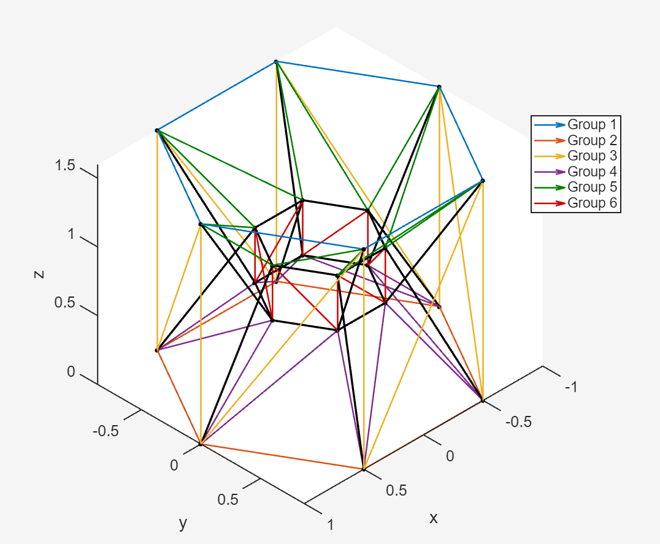
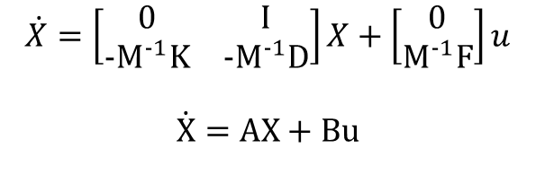
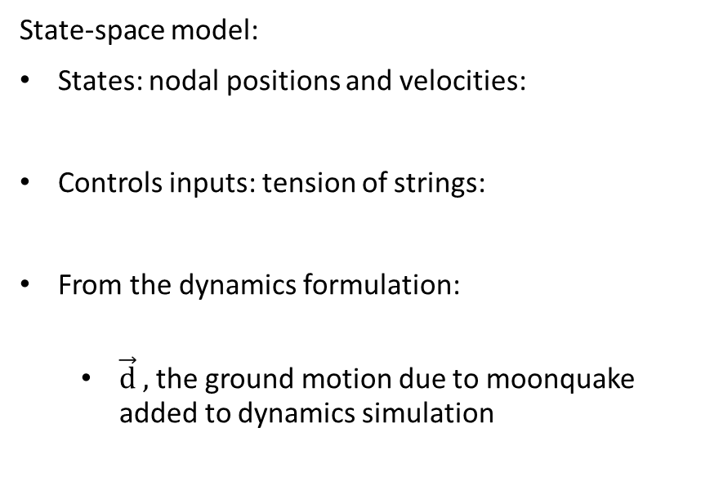



Control Design: framework
State-space model:
States: nodal positions and velocities:
Controls inputs: tension of strings:
From the dynamics formulation:
$\vec{d} ,$the ground motion due to moonquake added to dynamics simulation
$$X =\left(\begin{aligned}\vec{n} \\ \dot{\vec{n}}\end{aligned}\right)$$
$$u =\left(\begin{aligned}\vec{t_{1}} \\ \vec{t_{2}} \\ ... \\ \vec{t_{6}}\end{aligned}\right)$$
$$M\ddot{\vec{n}}+D\dot{\vec{n}}+K\vec{n}=f_{\text{ext}} =F\vec{u}$$
$$\dot{X}=\left[\begin{matrix}0 & I \\ -M^{-1}K & -M^{-1}D\end{matrix}\right]X+\left[\begin{aligned}0 \\ M^{-1}F\end{aligned}\right]u$$
$$\dot{X}=AX+Bu$$
Grouped strings for a unit

Slide 10


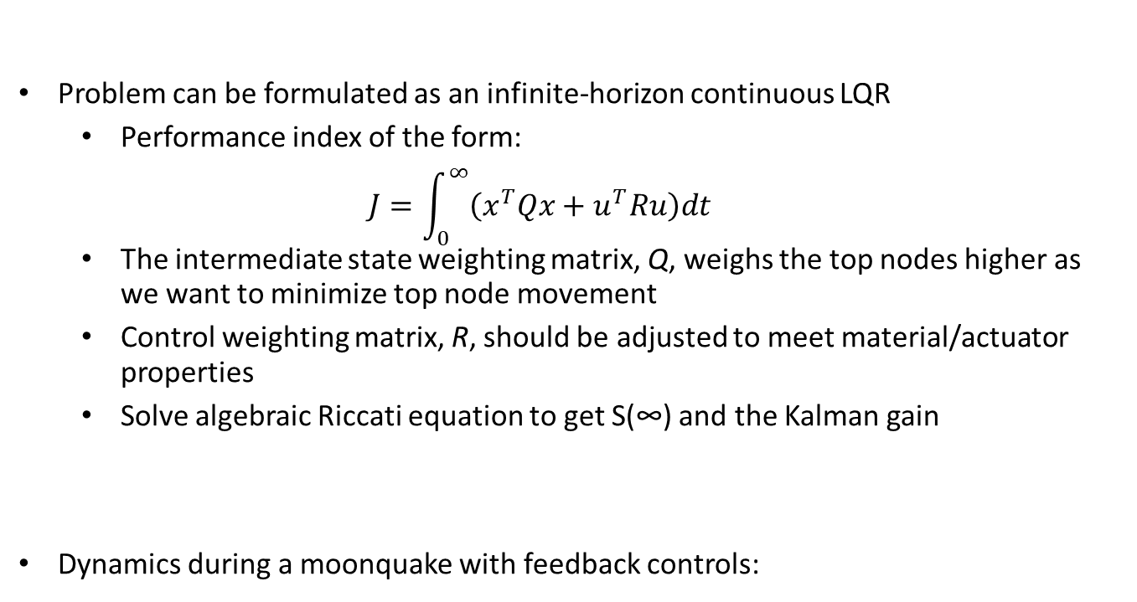
Control Design: Optimal Control
Problem can be formulated as an infinite-horizon continuous LQR
Performance index of the form:
$$J=\int_{0}^{∞}{\left(x^{T}Qx+u^{T}Ru\right)dt}$$
The intermediate state weighting matrix, Q, weighs the top nodes higher as we want to minimize top node movement
Control weighting matrix, R, should be adjusted to meet material/actuator properties
Solve algebraic Riccati equation to get S(∞) and the Kalman gain
Dynamics during a moonquake with feedback controls:
$$\dot{X}=AX+Bu+G d=(A-BK(\text{∞}\text{)) }\text{X}\text{+}\text{Gd}$$

Slide 11
Future work
Finalize dynamics validation
Apply LQR controller and tune weights
Compare controlled vs uncontrolled
Extend to non-linear model
Use Apollo seismograph data for disturbance

